Slide 1
MARCH
2025
INDIAN GENERAL ELECTIONS 2024
RESULT ANALYSIS
SQL | DAX | ETL | Data Analysis
Presented by S R Lohith

Slide 2
TABLE
of contents
01. About Me
02. Introduction
03. Problem Statement
04. DAX Queries
05. Connect with me

Slide 3

About Me
I am a Data Analyst dedicated to making sense of complex data and driving informed decision- making. With expertise in Python, SQL, Power BI, Tableau, and Excel, I have honed my skills in data extraction, analysis, and visualization to deliver actionable insights and solve real-world
problems.

Slide 4
Introduction
The Indian General Elections Result Analysis 2024 project aims to provide a comprehensive overview of the election results using SQL-based data analysis. This project leverages Microsoft SQL Server to extract, analyze, and visualize crucial election insights, including seat distribution, party performance, and candidate statistics. By utilizing structured queries and database relationships, we can uncover patterns in voting trends, regional seat allocations, and the performance of major alliances like NDA and I.N.D.I.A. The objective is to present data-driven insights that help in understanding the political landscape of India in 2024.

Slide 5
Problem Statement
To effectively analyze the Indian General Elections 2024, the following key questions were addressed:
What is the total number of seats available for elections in each state?
How many seats were won by each major political alliance (NDA, I.N.D.I.A, and Others)? Winning candidate's name, their party name, total votes, and the margin of victory for a specific state and constituency?
Which political parties performed best in terms of seats won?
What was the distribution of EVM votes versus postal votes for candidates in different constituencies?
Which party alliance won the most seats across all states?
For the state of Andhra Pradesh, what are the total number of seats, total number of candidates, total number of parties, total votes (including EVM and postal), and the breakdown of EVM and postal votes?

Slide 6
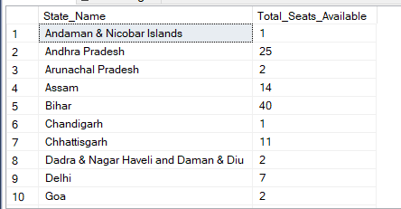
DAX QUERIES
1.What is the total number of seats available for elections in each state?
SELECT
s.State AS State_Name,
COUNT(cr.Constituency_ID) AS Total_Seats_Available FROM
constituencywise_results cr JOIN
statewise_results sr ON cr.Parliament_Constituency = sr.Parliament_Constituency
JOIN
states s ON sr.State_ID = s.State_ID GROUP BY
s.State ORDER BY
s.State;

Slide 7
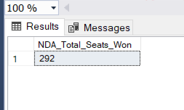
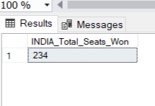
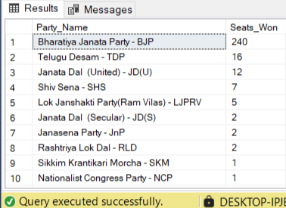
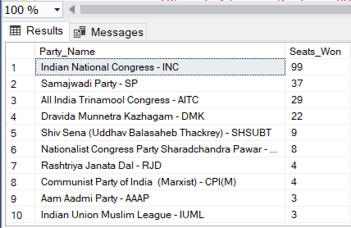
2. How many seats were won by each major political alliance (NDA, I.N.D.I.A, and Others)?
SELECT
SUM(CASE
WHEN party IN (
'Bharatiya Janata Party - BJP', 'Telugu Desam - TDP',
'Janata Dal (United) - JD(U)', 'Shiv Sena - SHS',
'AJSU Party - AJSUP',
'Apna Dal (Soneylal) - ADAL', 'Asom Gana Parishad - AGP',
'Hindustani Awam Morcha (Secular) - HAMS', 'Janasena Party - JnP',
'Janata Dal (Secular) - JD(S)',
'Lok Janshakti Party(Ram Vilas) - LJPRV', 'Nationalist Congress Party - NCP', 'Rashtriya Lok Dal - RLD',
'Sikkim Krantikari Morcha - SKM'
) THEN [Won] ELSE 0
END) AS NDA_Total_Seats_Won FROM
partywise_results

Slide 8
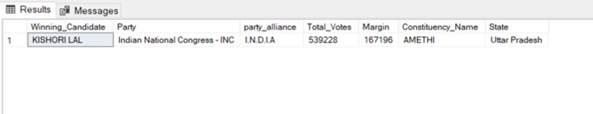
3. Winning candidate's name, their party name, total votes, and the margin of victory for a
specific state and constituency?
SELECT cr.Winning_Candidate, p.Party, p.party_alliance, cr.Total_Votes, cr.Margin, cr.Constituency_Name, s.State FROM constituencywise_results cr
JOIN partywise_results p ON cr.Party_ID = p.Party_ID
JOIN statewise_results sr ON cr.Parliament_Constituency = sr.Parliament_Constituency JOIN states s ON sr.State_ID = s.State_ID
WHERE s.State = 'Uttar Pradesh' AND cr.Constituency_Name = 'AMETHI';

Slide 9
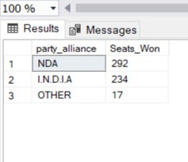
4. Which political parties performed best in terms of seats won?
SELECT
p.party_alliance, COUNT(cr.Constituency_ID) AS Seats_Won
FROM
constituencywise_results cr JOIN
partywise_results p ON cr.Party_ID = p.Party_ID WHERE
p.party_alliance IN ('NDA', 'I.N.D.I.A', 'OTHER') GROUP BY
p.party_alliance ORDER BY
Seats_Won DESC;

Slide 10
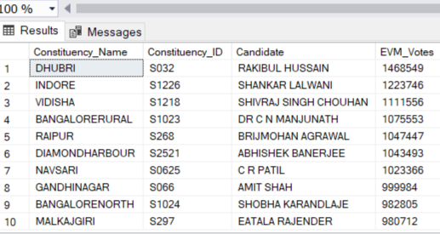
5. What was the distribution of EVM votes versus postal votes for candidates in different constituencies?
SELECT
cd.Candidate, cd.Party, cd.EVM_Votes, cd.Postal_Votes, cd.Total_Votes, cr.Constituency_Name
FROM
constituencywise_details cd JOIN
constituencywise_results cr ON cd.Constituency_ID = cr.Constituency_ID WHERE
cr.Constituency_Name = 'MATHURA' ORDER BY cd.Total_Votes DESC;

Slide 11
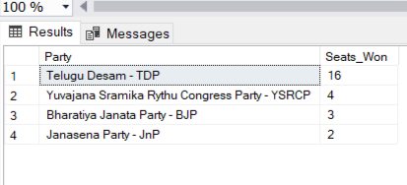
6. Which party alliance won the most seats across all states?
SELECT
p.Party,
COUNT(cr.Constituency_ID) AS Seats_Won FROM
constituencywise_results cr JOIN
partywise_results p ON cr.Party_ID = p.Party_ID JOIN
statewise_results sr ON cr.Parliament_Constituency = sr.Parliament_Constituency JOIN states s ON sr.State_ID = s.State_ID
WHERE
s.state = 'Andhra Pradesh' GROUP BY
p.Party ORDER BY
Seats_Won DESC;

Slide 12
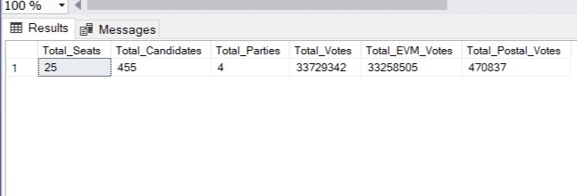
7. For the state of Andhra Pradesh, what are the total number of seats, total number of candidates, total number of parties, total votes (including EVM and postal), and the breakdown of EVM and postal votes?
SELECT
COUNT(DISTINCT cr.Constituency_ID) AS Total_Seats, COUNT(DISTINCT cd.Candidate) AS Total_Candidates, COUNT(DISTINCT p.Party) AS Total_Parties, SUM(cd.EVM_Votes + cd.Postal_Votes) AS Total_Votes, SUM(cd.EVM_Votes) AS Total_EVM_Votes, SUM(cd.Postal_Votes) AS Total_Postal_Votes
FROM
constituencywise_results cr JOIN
constituencywise_details cd ON cr.Constituency_ID = cd.Constituency_ID JOIN
statewise_results sr ON cr.Parliament_Constituency = sr.Parliament_Constituency JOIN
states s ON sr.State_ID = s.State_ID JOIN
partywise_results p ON cr.Party_ID = p.Party_ID WHERE
s.State = 'Andhra Pradesh';

Slide 13
KEY LEARNINGS
Real-World Application of Data Science
Applied data science techniques to analyze large-scale elections in a structured manner.
Learned how election data can influence political strategies and governance decisions.
Developed the ability to derive insights that can help journalists, policymakers, and citizens.
SQL Mastery & Data Analysis
Enhanced ability to write and optimize SQL queries for complex datasets.
Strengthened understanding of joins, aggregations, and data filtering techniques.
Improved efficiency in structuring large election datasets for meaningful insights.
Data Visualization & Storytelling
Learned to present election data through compelling visuals like bar charts and pie charts.
Understood the impact of clear and structured data representation for decision- making.
Gained experience in interpreting election trends through graphical analysis.

Slide 14

Conclusions
Conclusion 1
The analysis of the Indian General Elections
2024 provided critical insights into the distribution of seats among different political parties and alliances. The NDA and I.N.D.I.A alliances emerged as the most dominant forces in the elections, with their performance varying across different states. State-wise seat distribution highlighted the strongholds of each alliance, helping in understanding regional political trends.
Conclusion 2
Additionally, the study of vote distribution,
including EVM and postal votes, revealed the significance of different voting methods in shaping election outcomes. Candidate- specific analysis allowed for the identification of key figures in the elections and close electoral battles. Overall, this project demonstrates how data analytics can be leveraged to understand election dynamics and political shifts.

Slide 15



Connect with Me
Feel free to connect with me on my mail, Linkedin and Github! I’m passionate about Data Analytics, With experience in SQL, Python, Excel and Data Visualization. I enjoy working on projects that involve data - driven insights. Let’s collaborate and grow together.
MAIL : lohithmagnate2004@gmail.com
Linkedin Id : www.linkedin.com/in/lohith-s-r
Github : https://github.com/LohithSR

Slide 16


THANK YOU
Do Comment Your Thoughts

